Slide 1




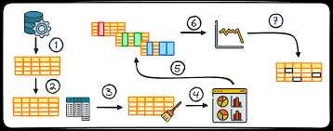




EDA for Credit Risk Analysis
A Case Study on Identifying Loan Defaulters and Their Factors
BIPUL RANJAN KUMAR
ANKIT KUMAR
Learner: Data Analysis
Learner: Data Analysis

Slide 2
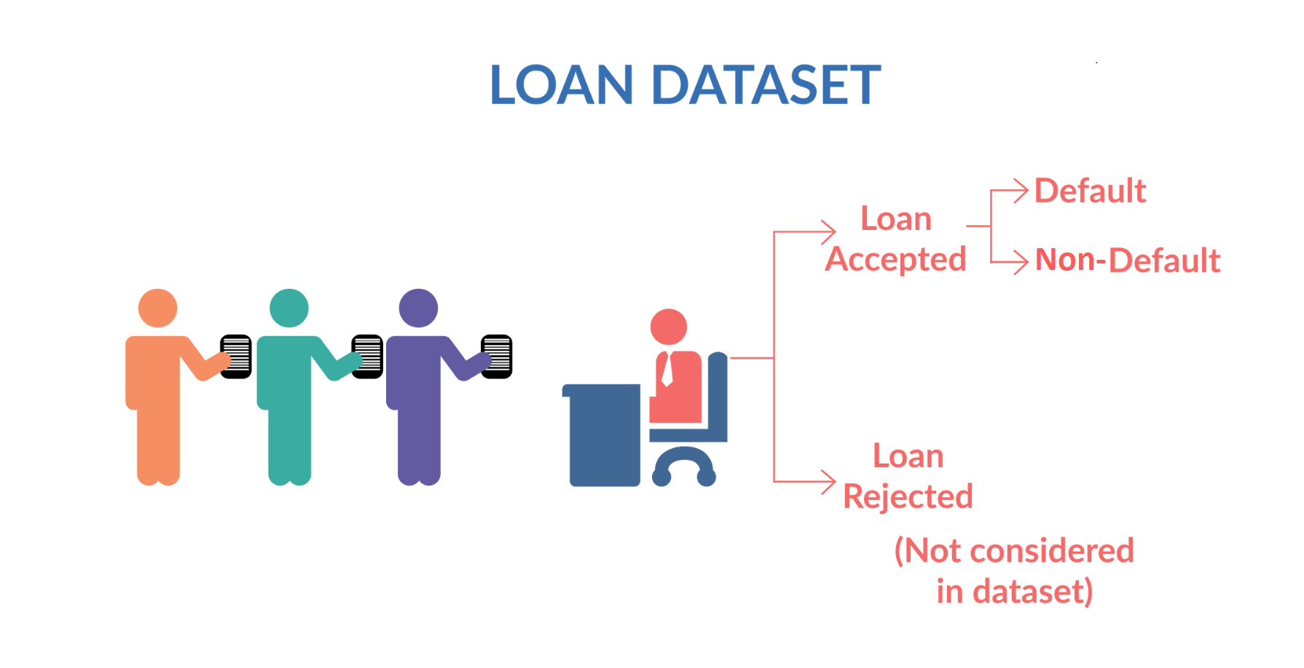









02
Objective
Utilize Exploratory Data Analysis (EDA) to uncover factors influencing loan defaults.
Loan Default Insights
Introduction
01
A leading consumer finance company specializes in lending various types of loans to urban customers. They face the challenge of identifying potential defaulters before granting loans. This case study aims to use Exploratory Data Analysis (EDA) to understand the factors that influence loan default and develop a predictive model to mitigate risks.
Problem Statement
Identifying potential loan defaulters is vital for reducing financial risk for institutions.
03
Dataset Overview
Key variables include loan amount, tenure, Interest Rate, credit history, and income, which are critical for analysis.

Slide 3







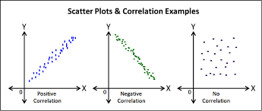

Exploratory Data Analysis
Exploratory Data Analysis
Data Cleaning and Preprocessing
Univariate Analysis
Bivariate Analysis
Key Steps and Insights in Credit Risk Assessment

Slide 4

Data Cleaning and Preprocessing
Fix Rows and Col
Fix Missing Values
Fix Invalid Values
Standardise Values
Filter Data

Slide 5
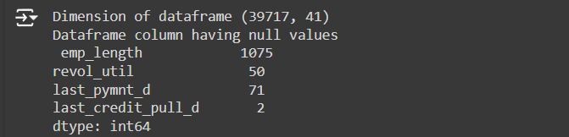
Data Cleaning and Preprocessing
1
2
Dimension of Dataframe = 39717 Rows and 111 Column
Number of columns with all rows as NA = 54
All columns were dropped from dataframe
Three Columns have majority NA
mths_since_last_delinq [25682 rows null]
mths_since_last_record [36931 rows null]
next_pymnt_d [38577 rows null]
All three columns were dropped
Dimension of Dataframe = 39717 Rows and 54 Column
Dropped the column having only one values
pymnt_plan | policy_code
title | collections_12_mths_ex_med
initial_list_status | acc_now_delinq
application_type | chargeoff_within_12_mth
delinq_amnt | tax_liens
4
3
Dimension of Dataframe = 39717 Rows and 41 Column
Cleaning the dataframe
Removed ‘months’ suffix from term column
Removed ‘%’ suffix from int_rate_percent column & revol_util_percent
Changed column issue_d, earliest_cr_line, last_pymnt_d and last_credit_pull_d to date[mmm-YY] format
Dimension of Dataframe = 39717 Rows and 44 Column
Dropped the column not needed for analysis
URL
emp_title
desc
Final Dimension of table

Slide 6

Univariate Analysis
Metadata description
Data distribution plots
Summary metrics

Slide 7
Univariate Analysis: Metadata description

Slide 8
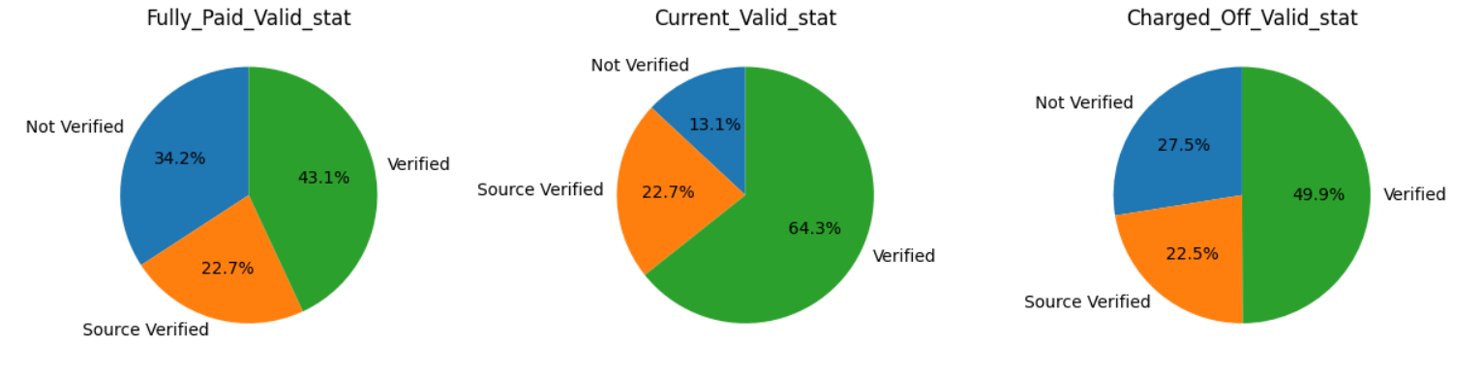

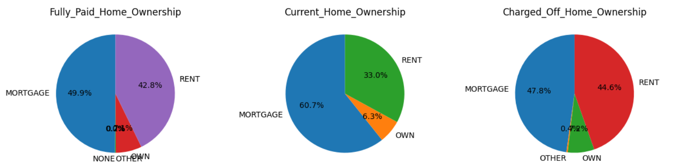
Univariate Analysis: Data Plots : Piecharts
Analysis of validation_status column
No Trend observed
Analysis of home_Ownership
column
No Trend observed

Slide 9
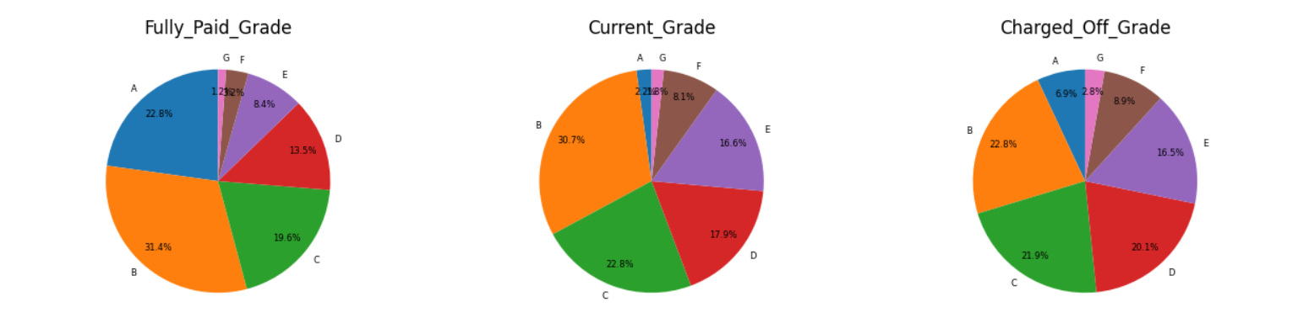

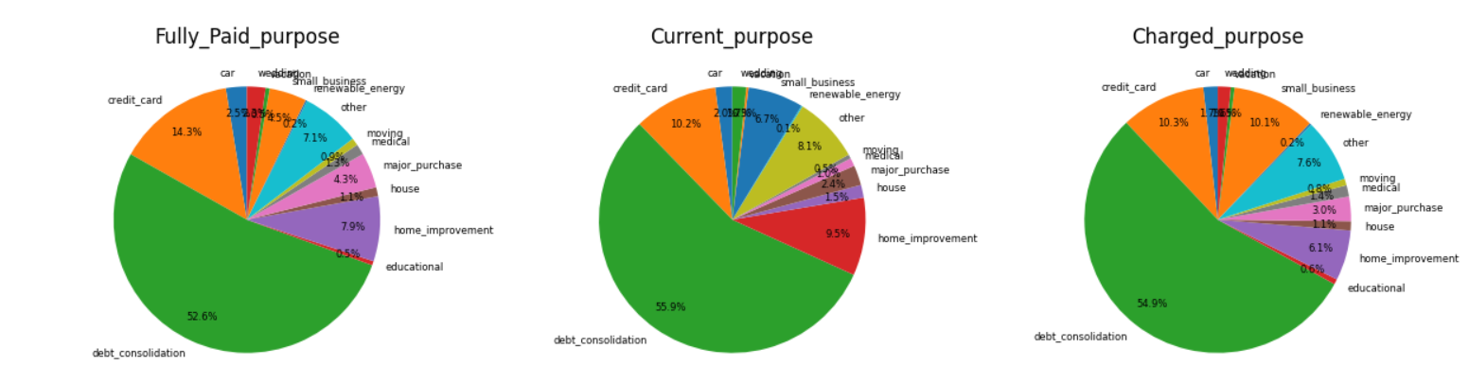
Univariate Analysis: Data Plots : Piecharts
Analysis of grade
column
Fully Paid cumulative % of A+B+C Grade is 73.8%
Charged off cumulative % of A+B+C Grade is 51.6%
Analysis of Purpose column
Debt_Consolidation has the highest % [54.9%] for the Charged off

Slide 10
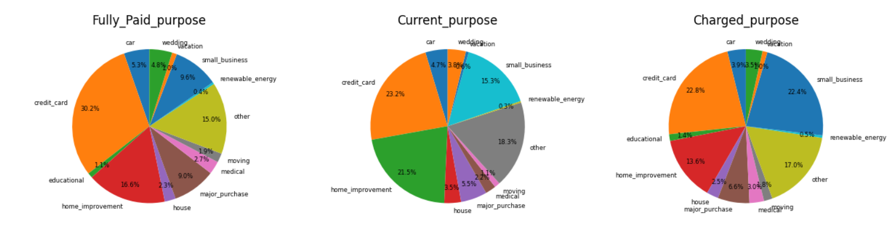
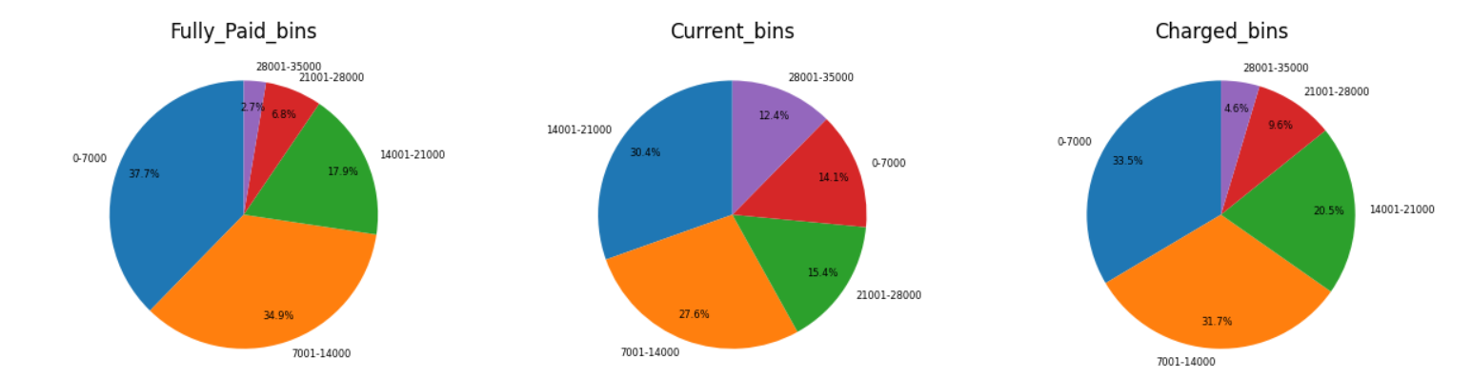
Univariate Analysis: Data Plots : Piecharts
Analysis of Purpose column [ without debt_consolidation purpose]
Fully Paid for small business is 9.6%
Charged off for small business is 22.4 %
Analysis loan amount column
80% of defaulter is having loan amount less than 21000

Slide 11
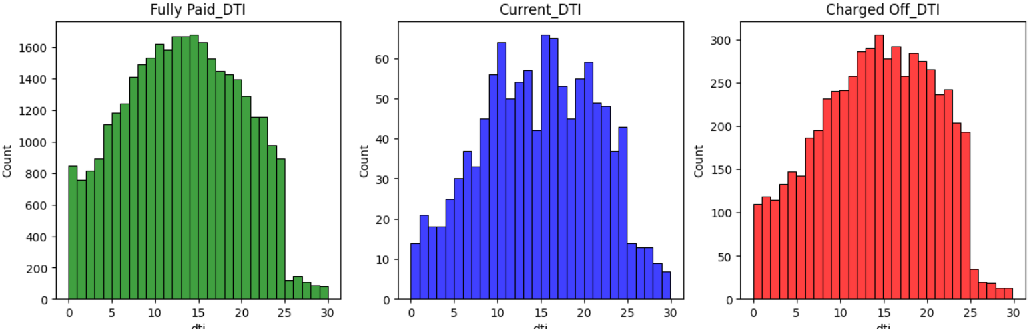
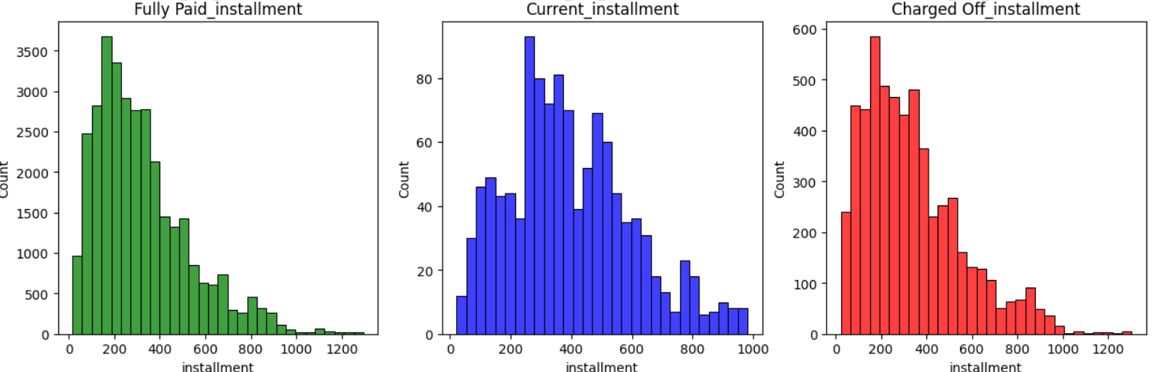
Univariate Analysis: Data Plots : Histogram
Analysis of DTI
column
No Trend observed
Analysis of Installment
column
No Trend observed

Slide 12
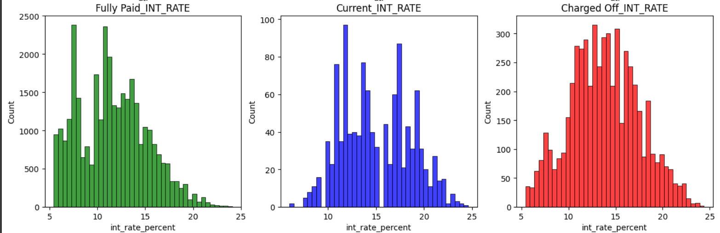
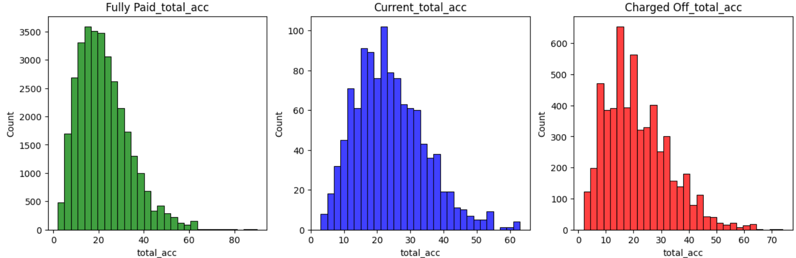
Univariate Analysis: Data Plots : Histogram
Analysis of
Interest Rate
column
Between Interest rate 11-17% is the highest defaulter
Analysis of total_acc
column
No Trend observed

Slide 13

Bivariate Analysis
Bivariate analysis on continuous variables
Bivariate analysis on categorical variables
Summary metrics

Slide 14
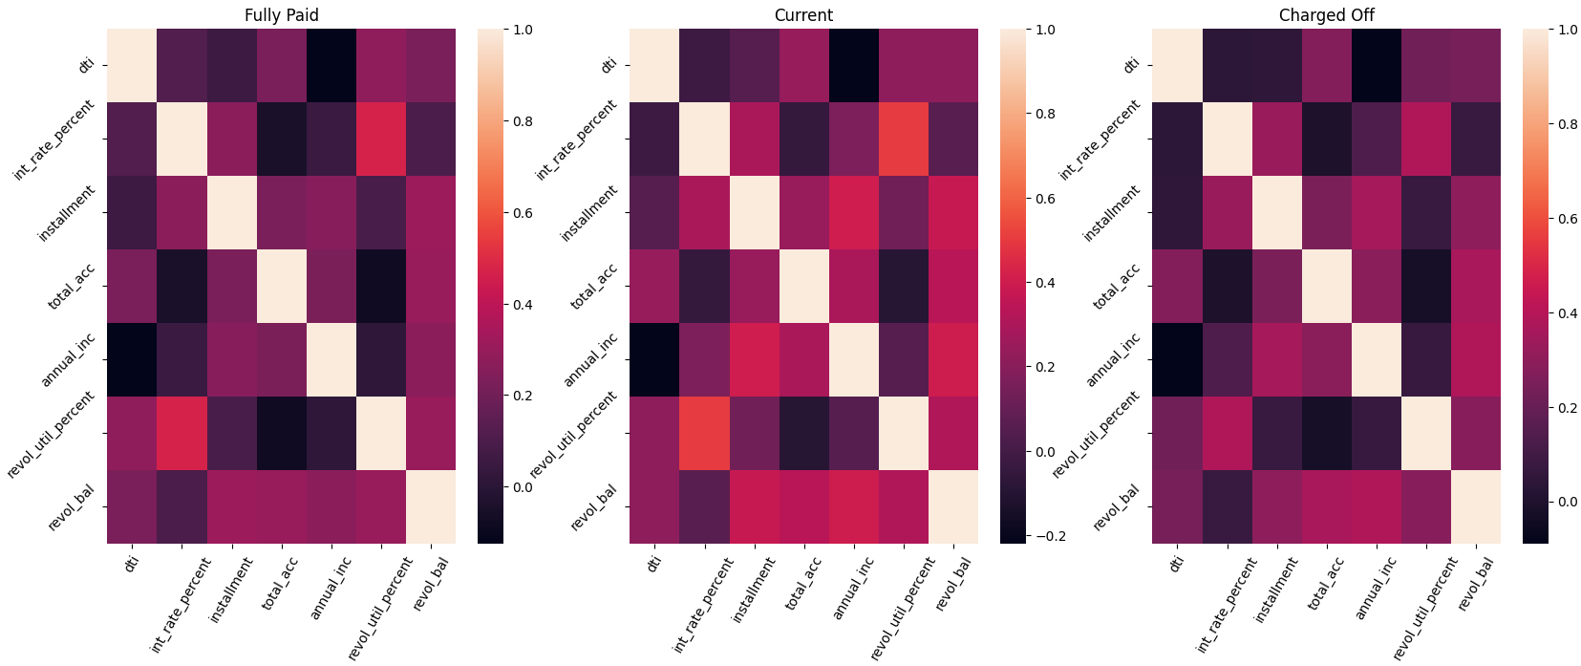
Bivariate Analysis: Data Plots : HeatMap
Analysis of correlation between column s
dti','int_rate_percent','installment','total_acc','annual_inc','revol_util_percent','revol_bal'
No Correlation observed

Slide 15



Loan Grade D,E,F and G has higher % of Defaulters ~50% in comparision of ~28% for fully paid
Loan taken for “Small Business” purpose has maximum defaulters ~22% [After removing Debt Consideration Type]
Interest rate 11-17% has highest % of Defaulters
Call to Action
Implement Findings to Enhance Credit Risk Assessments Today!

